Slide 1

Notes & Task Management Tool Using ML
Akash singh -22106065
Aditya Rawat-22106022
Mohit Rajput-22106126
Raj Patil-22106135
Project Guide
Mr. Mahesh Pawaskar

Slide 2
Outline
Introduction
Literature Survey of the Existing Systems
Limitations of the Existing Systems
Problem Statement
Proposed System Design
Framework/Algorithm
Technologies Stack for Proposed System
Implementation
Conclusion
References

Slide 3
Introduction
Problem Domain:
Managing tasks and notes efficiently is increasingly challenging due to information overload and numerous responsibilities.
Current tools like Trello and Evernote require manual organization, which can be time-consuming and error-prone, leading to missed deadlines and disorganization.
Current Solutions and Issues:
While existing tools offer basic task and note management, they lack intelligent features like automatic summarization, prioritization, and content suggestions.
Users often struggle with information overload, as these tools do not provide the necessary AI-driven support to streamline task and note management.

Slide 4
Motivation:
Observing widespread frustration with manual organization in current tools highlighted a significant gap in the market for smarter, AI-driven solutions.
Objectives:
Enhance Communication: Develop tools to convert informal text into formal language, improving clarity and professionalism in user communications.
Streamline Task Management: Create an intuitive interface for users to organize tasks and notes efficiently, promoting productivity and time management.
Utilize AI for Summarization: Implement AI-driven summarization features to help users quickly grasp essential information from lengthy texts.
Improve Professionalism in Writing: Address the need for professionalism in written content by providing features that refine language and enhance overall communication quality.

Slide 5
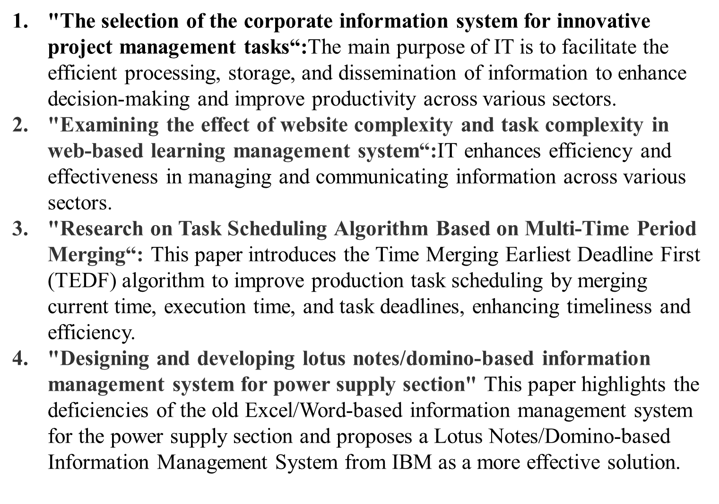
Literature Survey of the existing system

Slide 6
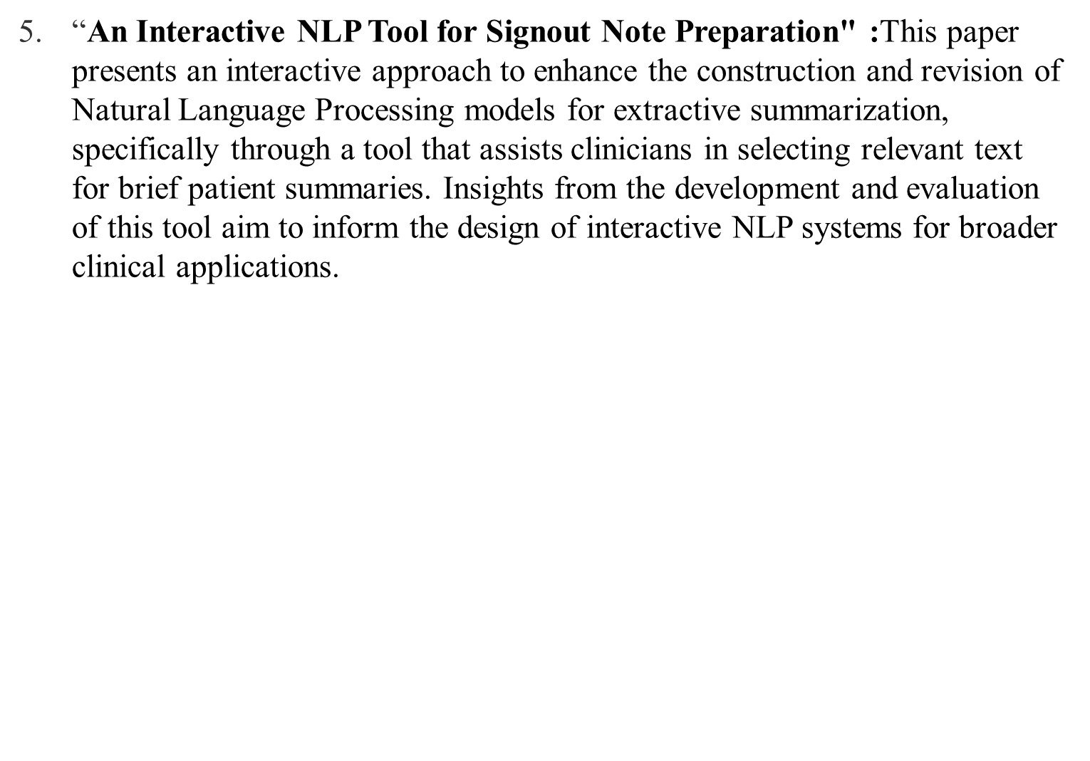
Literature Survey of the existing system

Slide 7
Limitations of Existing Systems
Lack of Contextual Understanding: Many existing systems struggle to comprehend the context of informal language, resulting in inadequate or irrelevant professionalization of text.
Ineffective Summarization: Current summarization tools often provide generic summaries that fail to capture the key points or nuances of the original content, leading to loss of important information.
User Interface Complexity: Existing task and note management systems often feature cluttered interfaces, making it difficult for users to navigate and efficiently manage their tasks and notes.
Limited Customization Options: Many systems do not offer customizable settings for professionalism levels or industry-specific language, hindering their applicability for diverse user needs and preferences.

Slide 8
Problem statement
Develop an advanced Task and Notes Management Tool that incorporates AI-driven features, including text professionalization, summarization, and task prioritization. This tool aims to enhance user productivity by addressing the challenges of effectively managing and organizing tasks and notes, ultimately assisting users in achieving better efficiency and clarity in their personal and professional lives.

Slide 9
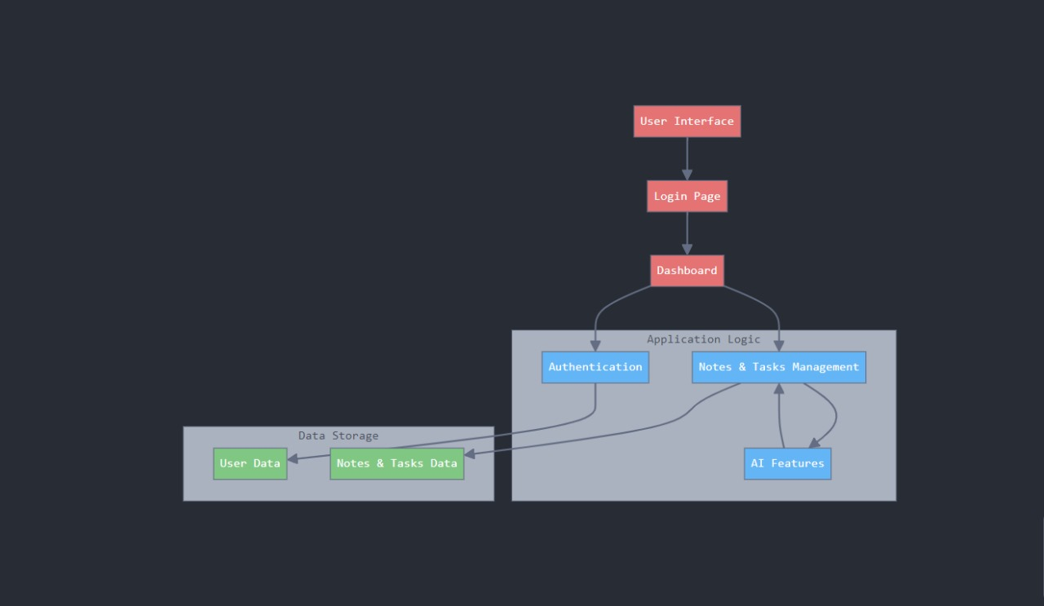
Proposed System Design

Slide 10
Framework/Algorithm
User Authentication: Validate user credentials against the MySQL database with encrypted passwords.
Dashboard Setup: Initialize the dashboard layout with sections for notes and tasks, displaying data from the database.
Data Management:
Add Notes: Input, validate, and save notes; display as squares.
View/Edit Notes: Enable viewing and editing of full note content.
Task Management:
Add Tasks: Input and save tasks with validation.
Edit/Complete Tasks: Modify tasks, mark as completed, and set priority levels.
Professionalism & Summarization: Process input text for professionalism enhancement and summarization, displaying results to users.

Slide 11
TECHNOLOGY STACK FOR PROPOSED SYSTEM
Frontend:
HTML: For structuring web pages and forms.
CSS: For styling and layout of the web application.
JavaScript: For client-side interactivity and dynamic content updates.
Backend:
PHP: For server-side scripting, handling form submissions, and database interactions.
Database:
MySQL: For storing user data, notes, and tasks securely.
Machine Learning:
NLP Techniques: Used for summarization and transforming informal text into formal text.
Data Processing Libraries
Web Server:
XAMPP: For setting up a local server environment to run PHP and MySQL.
PHP: Utilized for server-side processing and handling data storage with MySQL.
NLTK (Natural Language Toolkit): Used in Python for natural language processing tasks such as summarizing and formalizing text.

Slide 12
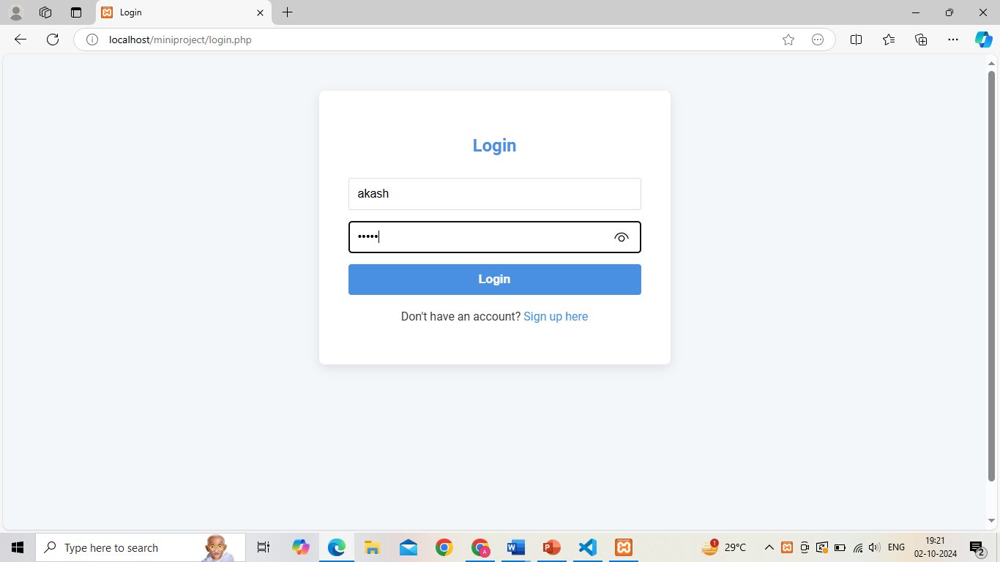
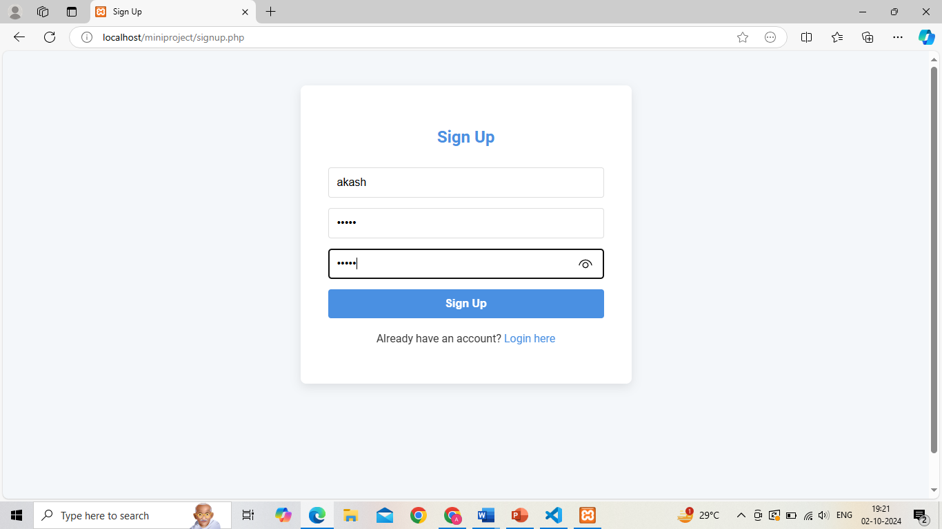
Implementation
Fig 1:login Page
Fig 2:Sign-up Page

Slide 13
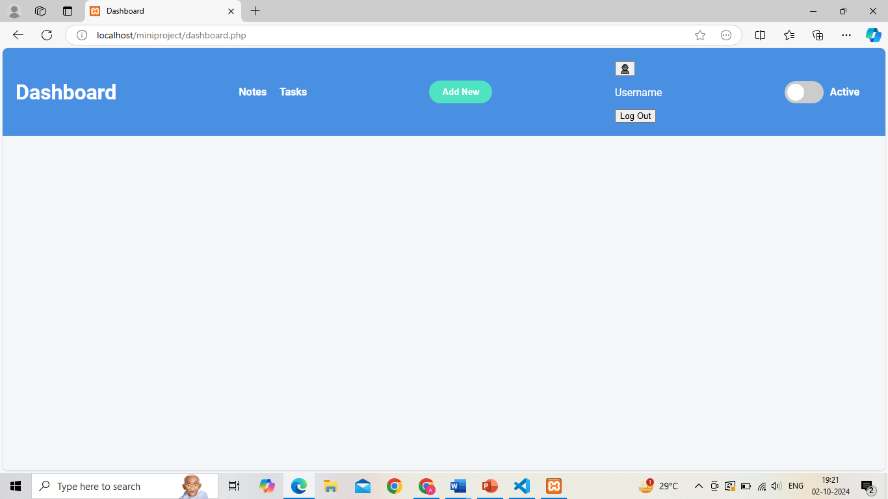
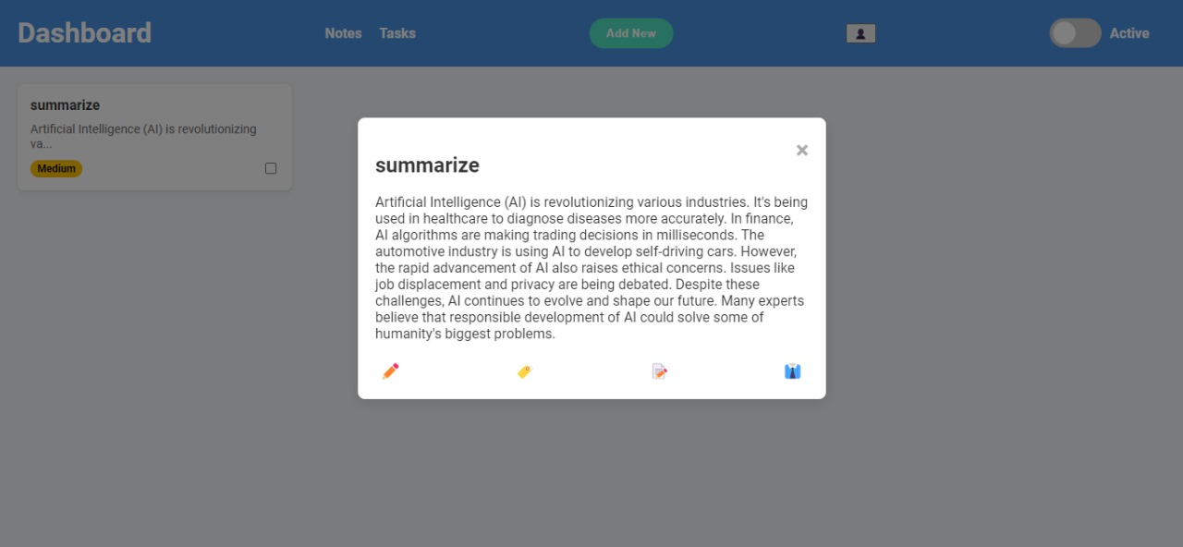
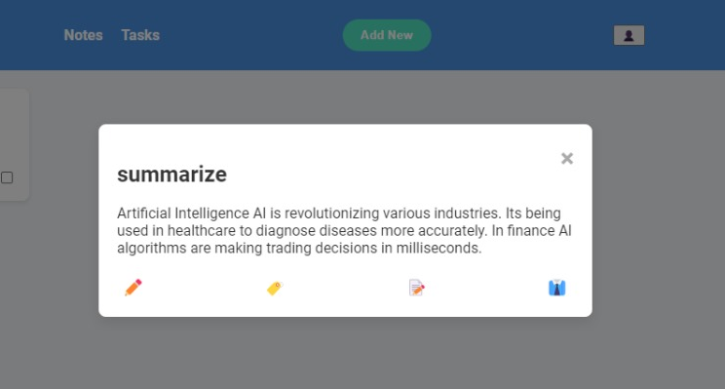
Fig 3:Dashboard Page
Fig 4:Summarize Page

Slide 14
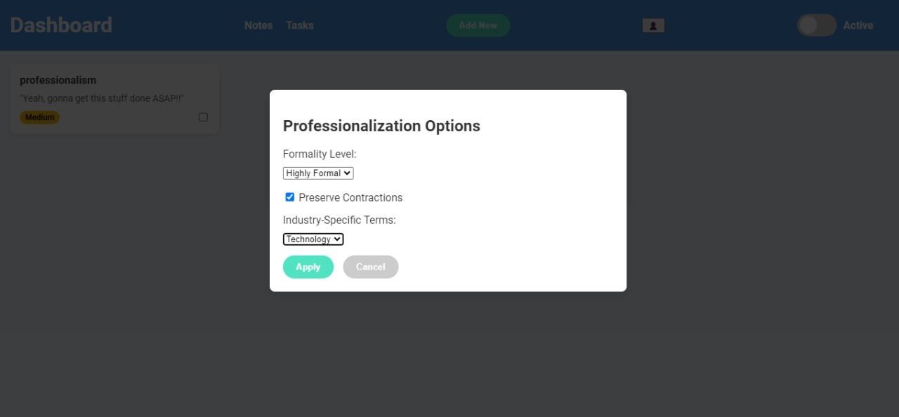
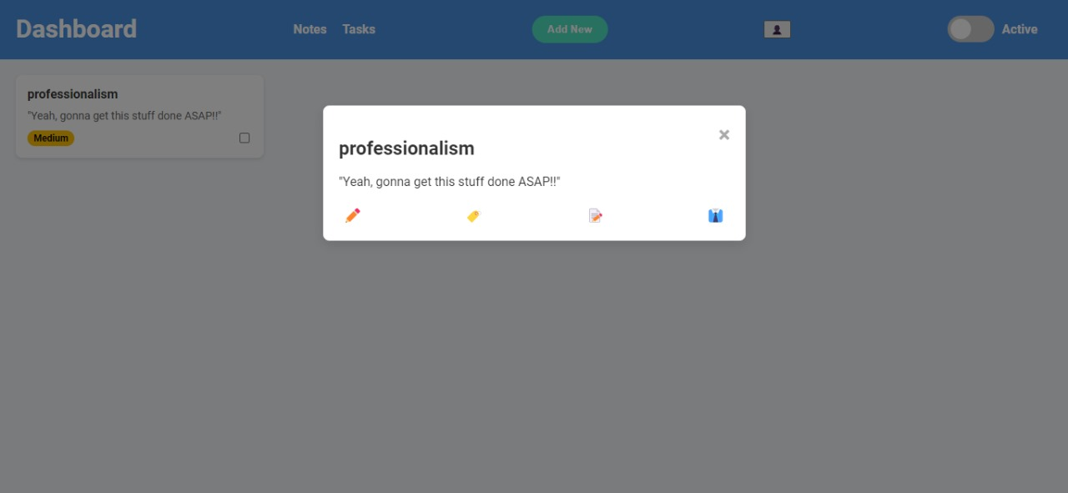
Fig 5: Professionalism Page

Slide 15
Conclusion:
we have developed a Task and Notes Management Tool that utilizes AI and machine learning to enhance user productivity. The application effectively addresses task and note management challenges, featuring summarization, automatic task prioritization, and the transformation of informal notes into professional formats. With a secure backend using MySQL and an intuitive front-end interface, we aim to further enhance user experience by integrating additional features, making this tool a valuable resource for optimizing task management and note-taking.

Slide 16
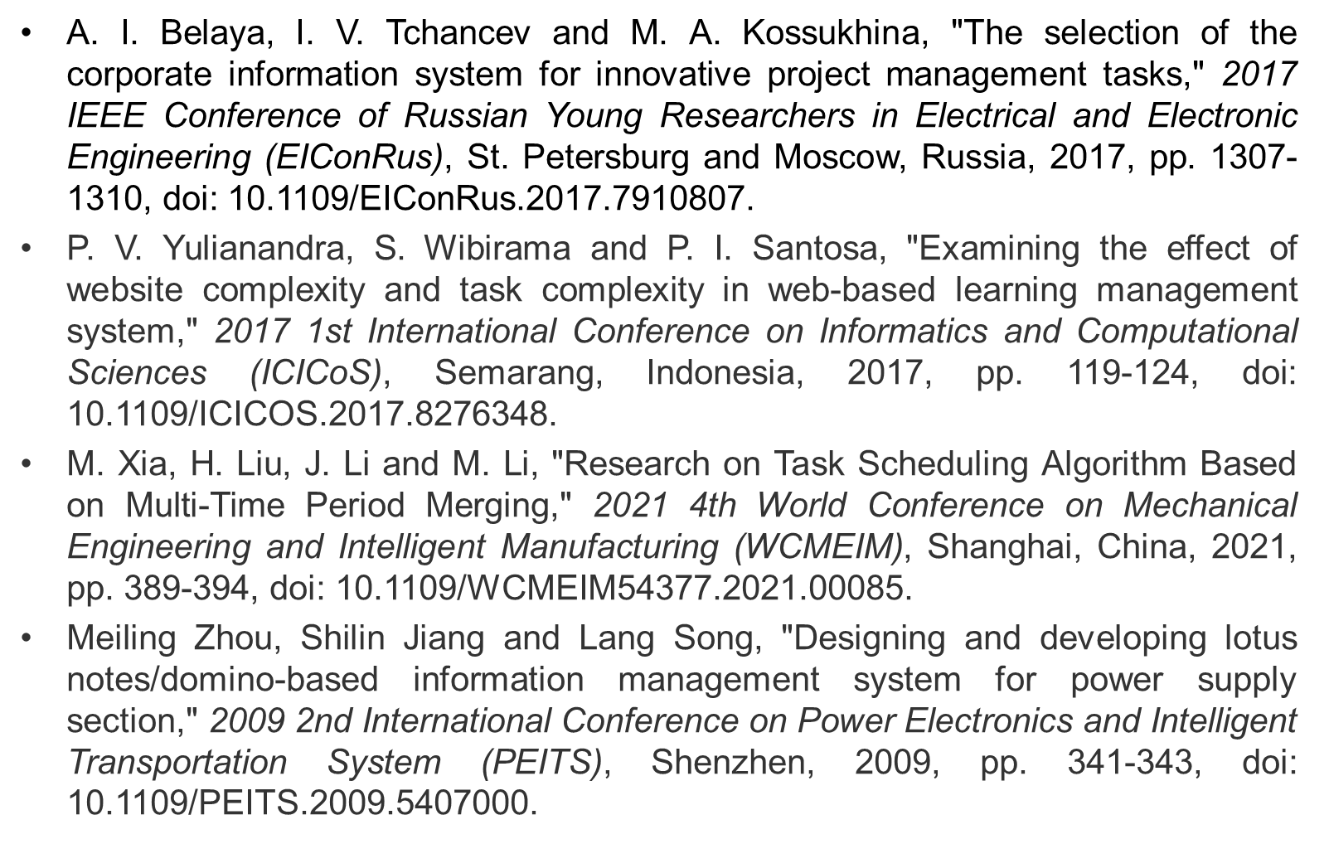
References

Slide 17
Thank You...!!

